Slide 1
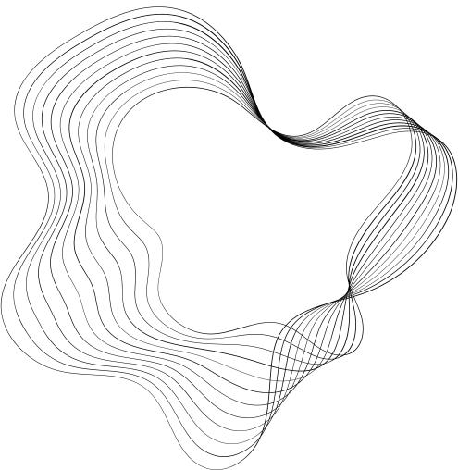


EGOLD HAVEN
A C2C/B2C Web Application for Gold Jewelry Trading.
IT-F23-01
Talha Ayub
01-135202-098
Hijab Sharif
01-135202-031
Supervisor: Mr. Ali Irfan

Slide 2

OUTLINE
01
INTRODUCTION
02
PROBLEM STATEMENT
03
OBJECTIVE
04
SCOPE
05
CORE CONCEPT
06
USER FUNCTIONALITIES
07
JEWELER FUNCTIONALITIES
08
ADMIN FUNCTIONALITIES
09
METHODOLOGY
10
TOOLS & TECHNOLOGIES

Slide 3





INTRODUCTION
EGold Haven is a specialized online marketplace (Web Application) exclusively dedicated to gold jewelry trading.
Empowering Sellers
Benefitting Buyers
Ensuring Authenticity
Independent Pricing for gold items.
Elimination of Intermediary fees.
Reduced market rates.
Transparent Pricing Insights.
Certification by Accredited Jewelers.
Jewelers earn commission in return.

Slide 4




PROBLEM STATEMENT
"In the gold jewelry trade, existing e-commerce platforms lack tailored solutions, leading to inflated prices and a lack of transparency. This highlights the need for a specialized platform like “EGold Haven” that empowers sellers, ensures authenticity, and enhances the buyer experience."
Price Disparities
Lack of Transparency
Limited Market Exposure

Slide 5


OBJECTIVE
“To develop a cost-effective gold jewelry marketplace web application, "EGold Haven," empowering sellers to set prices independently, reducing intermediary fees, and ensuring authenticity through certified jewelers, fostering trust and efficiency in the industry.”

Slide 6
SCOPE
EGOLD HAVEN
USERS
JEWELERS
ADMINS
BUYERS
SELLERS

Slide 7

CORE CONCEPT
PRODUCTS
SELLER
BUYER
Views
Administrate
Views
Contains
Creates
LISTINGS
STORE
JEWELER
Certifies
Manages
ADMINS

Slide 8
USER FUNCTIONALITIES
These include functionalities for both buyer and sellers.
➔Register User
➔Login User (Manual + SSO Login)
➔Reset Password
➔Edit Profile
➔Manage Listing (Create, Edit and Delete)
➔Request for Jeweler Status
➔Browse Listings
➔Search Listings
➔View Listing Details (Set Favorite)
➔Request Gold Certification
➔Access Forum
➔Initiate Chat
➔Receive Notifications

Slide 9
JEWELER FUNCTIONALITIES
Jeweler incorporates user functionalities as well as:
➔Manage Page
Add Products
Edit Products
Delete Products
Browse Products
➔Edit Profile
➔Initiate Chat
➔Request Commission Change
➔Receive Notifications
➔Approve / Reject Certification Requests

Slide 10
ADMIN FUNCTIONALITIES
Admins have a dashboard to handle requests such as:
➔Handle Requests
Approve / Reject Jeweler Status Requests
Approve / Reject Listings
Approve / Reject Products
Approve / Reject Commission Change Requests
➔View Dashboard
View Stats
View Users
View Jewelers
Browse Listings & Products

Slide 11
AGILE METHODOLOGY
Requirement Gathering & Analysis
Planning
Design
Development (Weekly Sprints)
Iteration & Feedback
Testing
Conduct Research
Identify Potential users & needs
Defining Project Scope
Database Design
Component Design
System Architecture
UI Design
Set up environment
Incremental feature development & integration
Weekly meetings with Supervisor
Incorporate feedback
Unit testing
Integration testing

Slide 12







TOOLS & TECHNOLOGY
01
02
03
04
05
06
CSS
JavaScript
MongoDB
Express
React
Node

Slide 13

THANK YOU !

